Slide 1
Chicago Insurance Redlining Example
Were insurance companies in Chicago denying insurance in neighborhoods based on race?

Slide 2
The background
In some US cities, services such as insurance are denied based on race
This is sometimes called “redlining.”
For insurance, many states have a “FAIR” plan available, for (and limited to) those who cannot obtain insurance in the regular market.
So an area with high numbers of FAIR plan policies is an area where it is hard to get insurance in the regular market.

Slide 3
The data (for 47 zip codes near Chicago)
involact = # of new FAIR plan policies and renewals per 100 housing units
race = % minority
theft = theft per 1000 population
fire = fires per 100 housing units
income = median family income in $1000s

Slide 4
First, some description
Descriptive statistics for the variables
Box plots
Histograms
Matrix plots
etc.

Slide 5
Descriptive Statistics: race, fire, theft, age, involact, income
Variable N N* Mean SE Mean StDev Minimum Q1 Median Q3
race 47 0 34.99 4.75 32.59 1.00 3.10 24.50 59.80
fire 47 0 12.28 1.36 9.30 2.00 5.60 10.40 16.50
theft 47 0 32.36 3.25 22.29 3.00 22.00 29.00 39.00
age 47 0 60.33 3.29 22.57 2.00 48.00 65.00 78.10
involact 47 0 0.6149 0.0925 0.6338 0.0000 0.0000 0.4000 0.9000
income 47 0 10.696 0.402 2.754 5.583 8.330 10.694 12.102
Variable Maximum
race 99.70
fire 39.70
theft 147.00
age 90.10
involact 2.2000
income 21.480

Slide 6
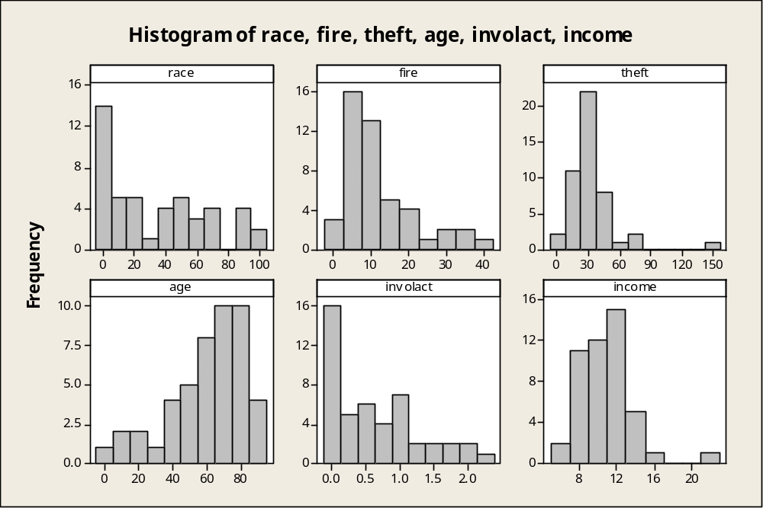

Slide 7
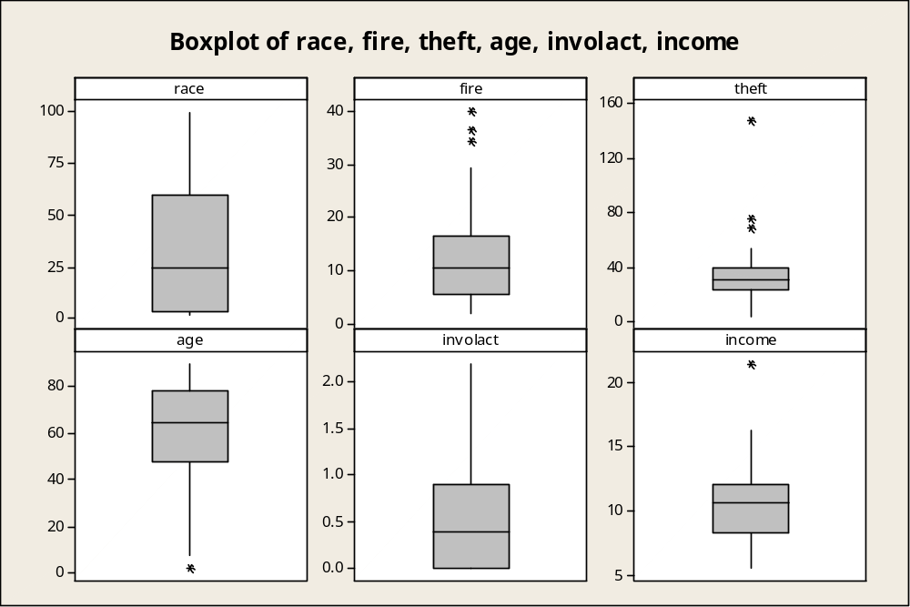

Slide 8
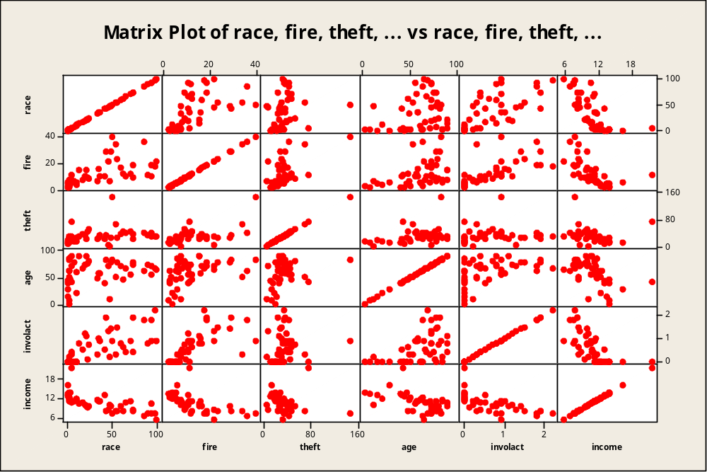

Slide 9
Simple linear regression model
Fit a model with involact as the response and race as the predictor
A strong positive relationship gives some evidence for redlining

Slide 10
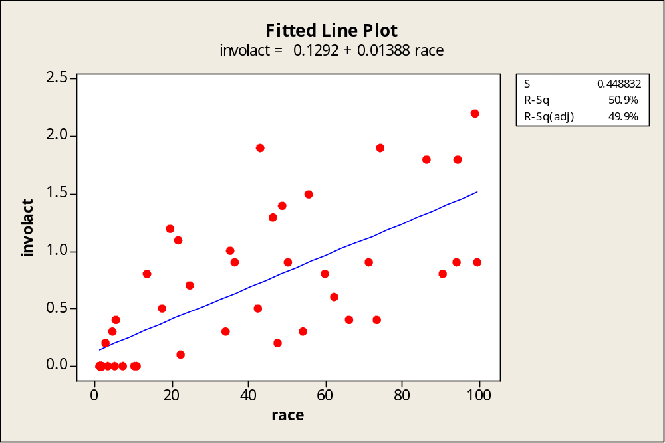

Slide 11
What’s next
The matrix plot showed that race is correlated with other predictors, e.g., income, fire, etc.
So it’s possible that these are the important factors in influencing involact
Next the full model is fit

Slide 12
The regression equation is
involact = - 0.609 + 0.00913 race + 0.0388 fire - 0.0103 theft + 0.00827 age
+ 0.0245 income
Predictor Coef SE Coef T P
Constant -0.6090 0.4953 -1.23 0.226
race 0.009133 0.002316 3.94 0.000
fire 0.038817 0.008436 4.60 0.000
theft -0.010298 0.002853 -3.61 0.001
age 0.008271 0.002782 2.97 0.005
income 0.02450 0.03170 0.77 0.444

Slide 13
S = 0.335126 R-Sq = 75.1% R-Sq(adj) = 72.0%
Analysis of Variance
Source DF SS MS F P
Regression 5 13.8749 2.7750 24.71 0.000
Residual Error 41 4.6047 0.1123
Total 46 18.4796

Slide 14
What have we learned?
Race is still highly significant (t = 3.94, p-value ≈ 0) in the full model
Income is not significant (this isn’t surprising, since race and income are highly correlated).

Slide 15
Diagnostics
Some plots are next.
Uninteresting (good!)
We’ll ignore more substantial diagnostics such as looking at leverage and influence, although these should be done.

Slide 16
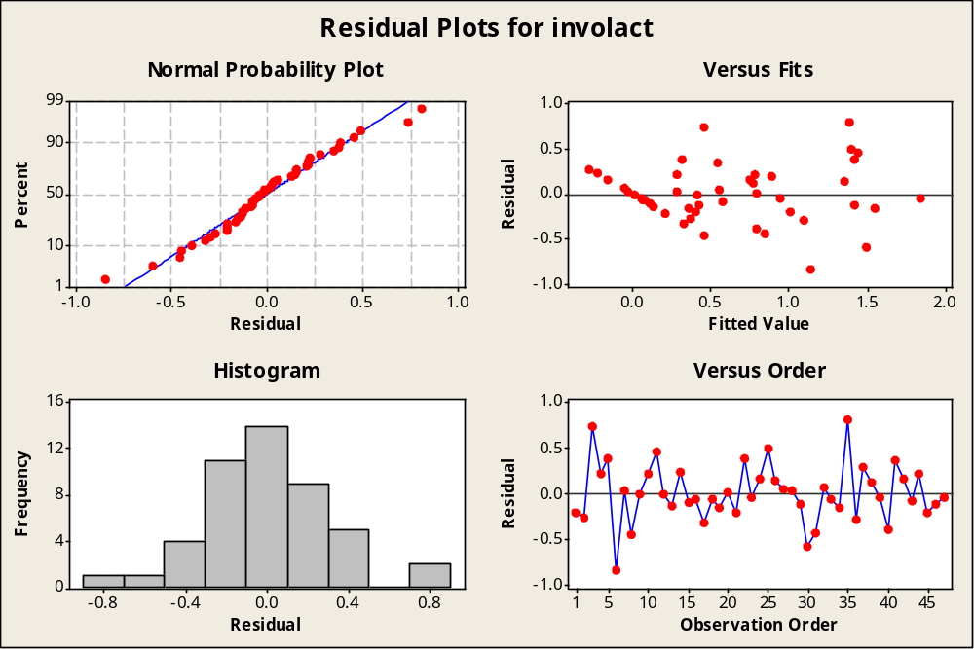

Slide 17
Model selection
Response is involact
i
t n
r f h c
a i e a o
Mallows c r f g m
Vars R-Sq R-Sq(adj) Cp S e e t e e
1 50.9 49.9 37.7 0.44883 X
2 63.0 61.3 19.8 0.39406 X X
3 69.3 67.2 11.5 0.36310 X X X
4 74.7 72.3 4.6 0.33352 X X X X
5 75.1 72.0 6.0 0.33513 X X X X X

